Slide 1
21CSA697A – Minor Project
February 2026
Machine Learning & Explainable AI
Employee Attrition
Prediction
A Comprehensive Machine Learning Approach for HR Analytics
Student Name
Register Number
Program
Amruta Kumbar
AA.SC.P2MCA24074031
MCA AI

Slide 2
INTRODUCTION
Understanding Employee Attrition
Domain Overview
Academic Relevance
Employee attrition refers to the voluntary departure of employees from an organization. It poses significant challenges including increased recruitment costs, loss of institutional knowledge, decreased productivity, and potential damage to customer relationships.
This project demonstrates practical application of:
Classification algorithms and ensemble methods
Feature engineering and data preprocessing
Explainable AI using SHAP values
Interactive dashboard development
Research Context
Practical Relevance
Studies show that replacing an employee costs 50-200% of their annual salary. Machine Learning enables proactive identification of at-risk employees, allowing HR to implement retention strategies before valuable talent is lost.
HR departments can leverage predictive analytics to reduce turnover rates, save recruitment costs, and maintain organizational stability through data-driven decision making.

Slide 3
PROBLEM STATEMENT
Challenges in Employee Retention
The Problem
Current Limitations
1
Reactive Approach
No predictive capability for early identification
Traditional HR relies on exit interviews and subjective assessments, which are reactive rather than proactive.
Manual analysis is time-consuming and error-prone
High Turnover Costs
Lack of explainability in existing ML models
2
Organizations struggle with significant financial and operational impacts due to unexpected employee departures.
Limited integration with HR systems
3
Lack of Insights
Limited understanding of key factors driving attrition makes it difficult to implement targeted retention strategies.
Research Gap
Need for an explainable, accurate, and practical machine learning system that can predict attrition risk while providing actionable insights for HR decision-makers.

Slide 4
OBJECTIVES
Project Goals
01
02
03
Develop Predictive Models
Achieve High Performance
Provide Explainability
Implement and compare multiple ML algorithms for attrition prediction
Optimize models to achieve high accuracy and reliability metrics
Use SHAP analysis to identify key factors affecting attrition
Logistic Regression
85%+
0.70+
Feature importance ranking
Decision Tree
Random Forest
Accuracy
ROC-AUC
Interpretable insights
XGBoost
65%+
20%+
Gradient Boosting
Individual prediction explanations
Precision
Recall
Develop Interactive Dashboard
Generate Actionable Insights
04
Create a user-friendly Streamlit dashboard for HR professionals to visualize predictions and explore insights
05
Provide specific recommendations for HR managers based on identified attrition drivers

Slide 5
SCOPE OF THE PROJECT
Project Boundaries
In Scope
Out of Scope
Data Analysis
Real-time Integration
IBM HR Analytics dataset with 1,470 employee records and 35 features
Live HR system integration (academic prototype only)
Model Development
Cloud Deployment
Five classification algorithms with hyperparameter tuning
Production-level cloud infrastructure
Explainability
Multi-tenant System
SHAP-based feature importance analysis
Support for multiple organizations
Dashboard
Interactive web-based dashboard using Streamlit
Assumptions
Dataset is representative of HR attrition patterns
Historical patterns remain consistent
Features capture relevant employee attributes

Slide 6
LITERATURE REVIEW
Related Research
1
Srivastava & Dey (2020)
"Comparative study of ML algorithms for employee churn prediction"
Ensemble Methods
Random Forest & Gradient Boosting outperformed single classifiers
2
Ahmad et al. (2021)
"Predicting employee turnover using logistic regression and decision tree"
Feature Selection
Highlighted importance of feature selection in improving model performance
3
Kumar & Sharma (2020)
"Employee attrition prediction using XGBoost algorithm"
XGBoost
Achieved 88% accuracy; emphasized hyperparameter tuning importance
4
Molnar (2022)
"Interpretable Machine Learning: A Guide for Making Black Box Models Explainable"
Explainable AI
Comprehensive insights into SHAP values for model interpretability

Slide 7
RESEARCH GAP
Identified Gaps in Existing Research
Limited Explainability
Dashboard Integration
Many existing studies focus solely on prediction accuracy without providing interpretable insights that HR managers can use for decision-making.
Few studies integrate predictive models with user-friendly dashboards for practical deployment in HR departments.
Our Solution: SHAP-based explainability with feature importance rankings
Our Solution: Interactive Streamlit dashboard with real-time predictions
Dataset Diversity
Comprehensive Comparison
Most studies use limited datasets that may not represent diverse organizational contexts and industries.
Limited comparative analysis of multiple algorithms with consistent evaluation metrics and validation strategies.
Our Solution: Comprehensive analysis with detailed feature engineering
Our Solution: Systematic comparison of 5 algorithms with cross-validation
Our Contribution
This project addresses all identified gaps by providing an explainable, accurate, and practical ML system with interactive visualization capabilities.

Slide 8
PROPOSED SYSTEM
Research Methodology
Overall Workflow
Justification of Approach
Novelty & Innovation
1
Data Collection & Loading
Ensemble Methods: Proven superior performance for classification tasks
Comprehensive Comparison: Systematic evaluation of 5 algorithms
2
Data Preprocessing
3
Feature Engineering
4
Model Training
SHAP Values: Industry standard for model explainability
Actionable Insights: SHAP analysis provides specific recommendations
5
Model Evaluation
6
Explainability Analysis
Cross-Validation: Ensures model robustness and generalizability
Interactive Dashboard: Real-time predictions with visualization
7
Dashboard Development
Stratified Sampling: Handles class imbalance effectively
Feature Engineering: Derived meaningful new features
Key Innovation
Combining high predictive accuracy with interpretable insights through SHAP analysis, enabling HR managers to understand not just who might leave, but why they might leave.

Slide 9
SYSTEM ARCHITECTURE
Architecture & Data Flow
Data Ingestion
Preprocessing
Feature Engineering
Model Training
Load employee data from CSV files and perform initial validation
Handle missing values, encode categories, scale features
Create new features and perform dimensionality reduction
Train multiple classification algorithms with hyperparameter tuning
Evaluation
Explainability
Dashboard
Compute performance metrics and generate evaluation reports
Generate SHAP values for model interpretation and insights
Provide interactive visualization through Streamlit interface
End-to-End ML Pipeline

Slide 10
METHODOLOGY & ALGORITHMS
Machine Learning Approach
1
Logistic Regression
4
XGBoost
Statistical model for binary classification using logistic function
Optimized gradient boosting with sequential tree building
P(Y=1|X) = 1/(1 + e^-(β₀+β₁X₁+...))
Fₘ(x) = Fₘ₋₁(x) + η·hₘ(x)
2
Decision Tree
5
Gradient Boosting
Tree-like model creating decisions based on feature values
Stage-wise ensemble combining weak learners into strong learner
Non-parametric, interpretable
Optimizes loss function via gradient descent
3
Random Forest
SHAP Analysis
Ensemble method constructing multiple decision trees
SHapley Additive exPlanations for model interpretability
ŷ = (1/N)∑ᵢ₌₁ᴺ fᵢ(x)
Feature importance & individual predictions

Slide 11
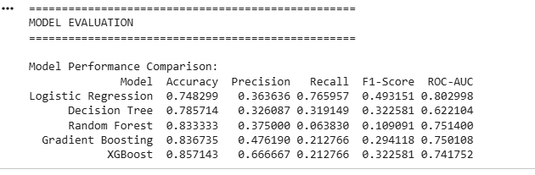
RESULTS & OUTPUT
Actual Model Performance
Model Performance Comparison - Actual Results
Best Accuracy
Best Precision
Best Recall
Best F1-Score
Best ROC-AUC
85.7%
66.7%
76.6%
49.3%
0.803
XGBoost
XGBoost
Logistic Reg
Logistic Reg
Logistic Reg
Key Finding
XGBoost achieved the highest accuracy (85.7%) among all models, while Logistic Regression showed the best ROC-AUC score (0.803) and highest recall (76.6%).

Slide 12
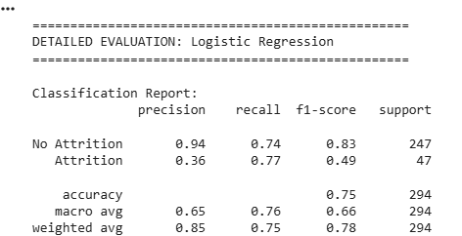
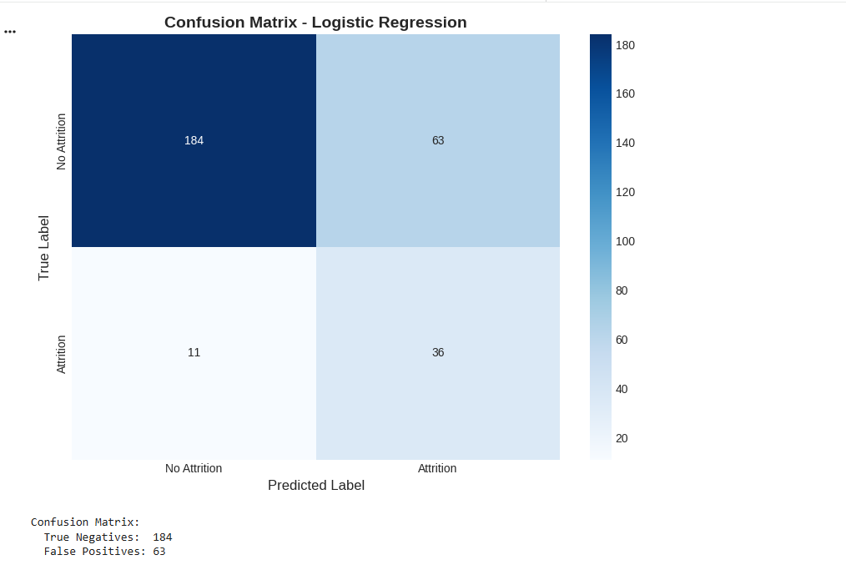
RESULTS & OUTPUT
Detailed Evaluation & Confusion Matrix
Logistic Regression - Classification Report
Confusion Matrix - Logistic Regression
184
63
11
36
True Negatives
False Positives
False Negatives
True Positives
(Correctly predicted No Attrition)
(Incorrectly predicted Attrition)
(Missed Attrition cases)
(Correctly predicted Attrition)

Slide 13
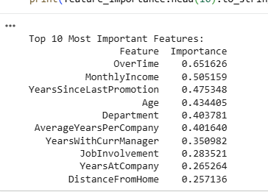
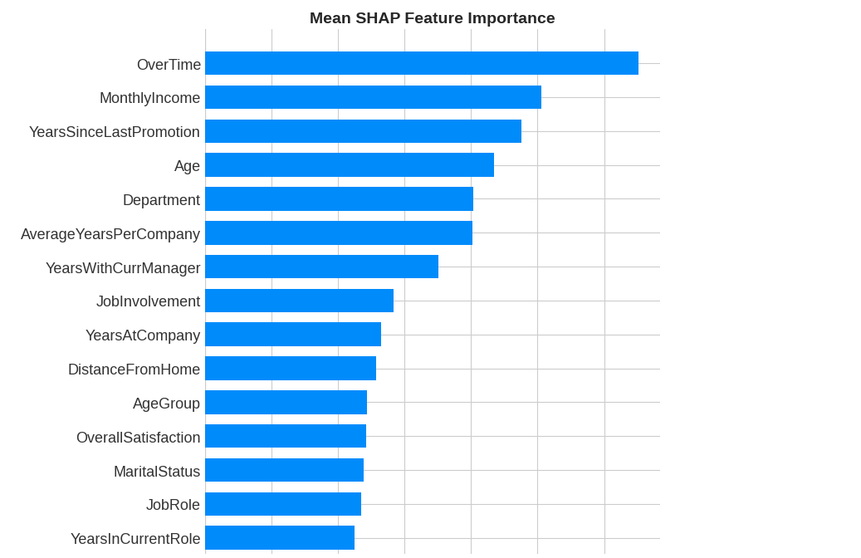
EXPLAINABILITY ANALYSIS
Feature Importance & SHAP Analysis
Top 10 Most Important Features
Mean SHAP Feature Importance
#1: OverTime
#2: MonthlyIncome
#3: YearsSinceLastPromotion
Importance: 0.652
Importance: 0.505
Importance: 0.475
Key Insights from SHAP Analysis
OverTime is the most important predictor of employee attrition, followed by Monthly Income and Years Since Last Promotion. These insights help HR managers focus on the most critical factors for retention strategies.

Slide 14
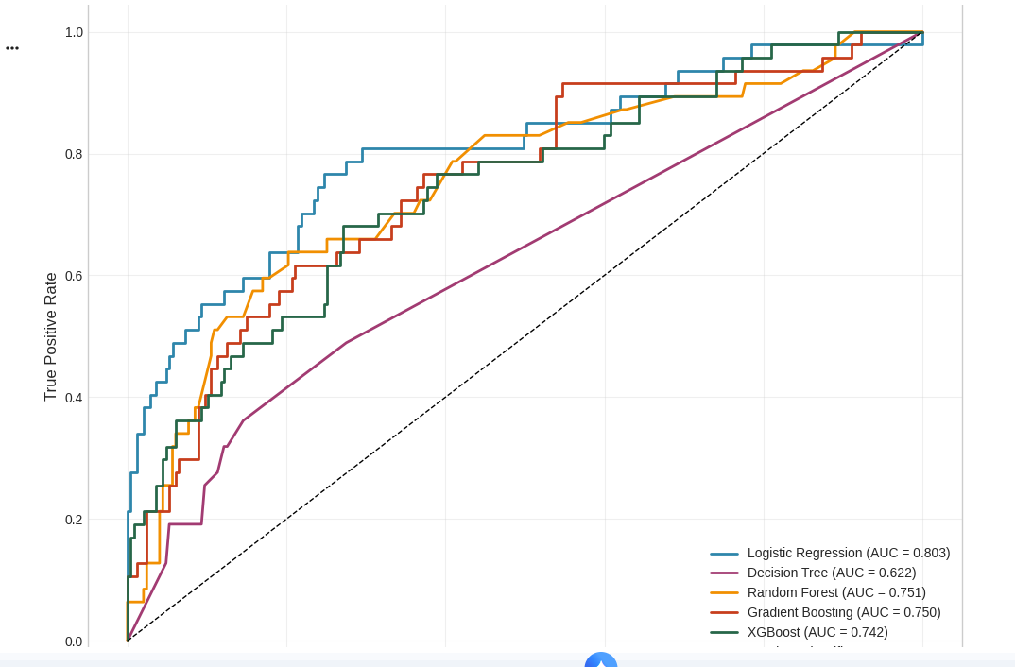
RESULTS & OUTPUT
ROC Curve Analysis
ROC Curve Comparison - All Models
0.803
0.751
0.750
0.742
0.622
Logistic Reg
Random Forest
Gradient Boost
XGBoost
Decision Tree
Best AUC
ROC-AUC Analysis
Logistic Regression achieved the highest ROC-AUC score (0.803), indicating excellent discriminative ability between employees who will leave and those who will stay. All models performed above the random classifier baseline (diagonal line).

Slide 15
DATASET & IMPLEMENTATION
Dataset Description & Tools
IBM HR Analytics Dataset
Tools & Technologies
Python 3.8+
Pandas
1,470
35
Primary language
Data manipulation
Employee Records
Features
NumPy
Scikit-learn
Demographic data (Age, Gender, Marital Status)
Numerical computing
ML algorithms
Job-related attributes (Department, Job Role, Level)
XGBoost
SHAP
Compensation (Monthly Income, Hourly Rate)
Gradient boosting
Explainability
Satisfaction metrics (Job, Environment, Work-Life)
Matplotlib/Seaborn
Streamlit
Visualization
Dashboard
Preprocessing Steps
1
Missing value handling
2
Categorical encoding (Label & One-Hot)
GitHub Repository
3
Feature scaling (StandardScaler)
github.com/amrutakumbar/
4
Feature engineering (derived features)
employee-attrition-prediction
Public
Open Source

Slide 16
DASHBOARD DEMO
Interactive Streamlit Dashboard
Single Prediction
Feature Importance
Input individual employee details and receive instant attrition risk prediction with probability score.
Visualize SHAP values and feature importance rankings with interactive charts.
# Example Input
SHAP Summary Plot
Force Plot
Age: 28 years
Monthly Income: $3,500
OverTime: Yes
# Output
Attrition Risk: 78%
Model Performance
Display accuracy metrics, confusion matrices, and ROC curves for all trained models.
Batch Prediction
85.7%
66.7%
0.803
Upload CSV files for bulk predictions across entire employee database.
Accuracy
Precision
ROC-AUC
Upload employee_data.csv
Download results with predictions
Launch Dashboard
Localhost:8501
Interactive
streamlit run app.py

Slide 17
TESTING & VALIDATION
Quality Assurance
Testing Strategy
Error Analysis
Robustness Checks
Hold-out validation (80-20 split)
False Positives: 63 cases
Consistent across CV folds
5-fold cross-validation
False Negatives: 11 cases
Stable with different seeds
Stratified sampling
Error rate: 25.2%
No overfitting detected
Validation Metrics
Cross-Validation Results
0.803
0.49
Mean CV Accuracy
82.5%
ROC-AUC Score
F1-Score
Standard Deviation
±2.3%
66.7%
76.6%
Precision
Recall
Best Fold Score
85.7%

Slide 18
CONCLUSION
Summary of Work Done
High-Performance Model
Practical Dashboard
XGBoost classifier achieved 85.7% accuracy, with Logistic Regression showing the best ROC-AUC score of 0.803.
An interactive Streamlit dashboard was developed to enable HR professionals to visualize predictions and explore insights.
Comprehensive Comparison
Actionable Recommendations
Five ML algorithms were systematically compared, with ensemble methods showing competitive performance.
Specific recommendations for HR managers to implement targeted retention strategies based on identified attrition drivers.
Explainable Insights
Academic Contribution
SHAP analysis identified OverTime, Monthly Income, and Years Since Last Promotion as top attrition predictors.
Demonstrated practical application of classification, ensemble methods, and explainable AI concepts.
Achievement of Objectives
All five project objectives have been successfully achieved. The system provides an explainable, accurate, and practical solution for employee attrition prediction.

Slide 19
FUTURE ENHANCEMENTS
Future Scope
Deep Learning
Real-time Integration
Multi-source Data
Explore neural network architectures such as LSTM or Transformer models for sequential employee data analysis.
Develop APIs for integration with HR information systems (HRIS) for real-time predictions and monitoring.
Incorporate additional data sources such as employee surveys, performance reviews, and external market data.
Temporal Analysis
Intervention Modeling
Fairness Analysis
Implement time-series analysis to track attrition trends over time and predict seasonal patterns.
Develop models to predict the effectiveness of different retention interventions and strategies.
Ensure the model is fair across different demographic groups and does not exhibit bias in predictions.
Mobile Application
Multi-organization Dataset
Develop a mobile app for HR managers to access predictions and insights on-the-go.
Train models on diverse datasets from multiple organizations to improve generalizability.

Slide 20
Thank You
Student Name
Project Title
Amruta Kumbar
Employee Attrition Prediction
Register Number
Program
AA.SC.P2MCA24074031
Master of Computer Applications -AI
AA.SC.P2MCA24074031@ahead.students.amrita.edu
21CSA697A – Minor Project | February 2026

